Slide 1
What is ARM?
Advanced RISC Machine
ARM is the first advanced micro processor used for commercial purpose
APPLICATIONS:
Video game controllers
Mobile phones
Modems
Handy cams

Slide 2
Data Size
ARM7 is a 32-bit processor architecture
i.E V7 version( Registers to be 32- bit)
Version 8 is 64- bit architecture (Registers are to be 64-bit)
With respect to 32-bit ARM architecture:
Byte means 8-bits
Half word means 160bits(two bytes)
Word means 32-bits

Slide 3
ARM implements two instructions
32-bit ARM instruction set
16-bit Thumb instruction set
Java byte code can also be implemented

Slide 4
Classification of Microprocessors:
Besides the classification based on the word length, the classification is also based on the architecture i.e. Instruction Set of the microprocessor. These are categorised into RISC and CISC.

Slide 5
RISC:
It stands for Reduced Instruction Set Computer. It is a type of microprocessor architecture that uses a small set of instructions of uniform length.
These are simple instructions which are generally executed in one clock cycle. RISC chips are relatively simple to design and inexpensive.
The setback of this design is that the computer has to repeatedly perform simple operations to execute a larger program having a large number of processing operations.

Slide 6
EPIC:
It stands for Explicitly Parallel Instruction Computing. The best features of RISC and CISC processors are combined in the architecture. It implements parallel processing of instructions rather than using fixed length instructions

Slide 7
CISC:
It stands for Complex Instruction Set Computer. These processors offer the users, hundreds of instructions of variable sizes.
CISC architecture includes a complete set of special purpose circuits that carry out these instructions at a very high speed.
These instructions interact with memory by using complex addressing modes. CISC processors reduce the program size and hence lesser number of memory cycles are required to execute the programs. This increases the overall speed of execution.

Slide 8
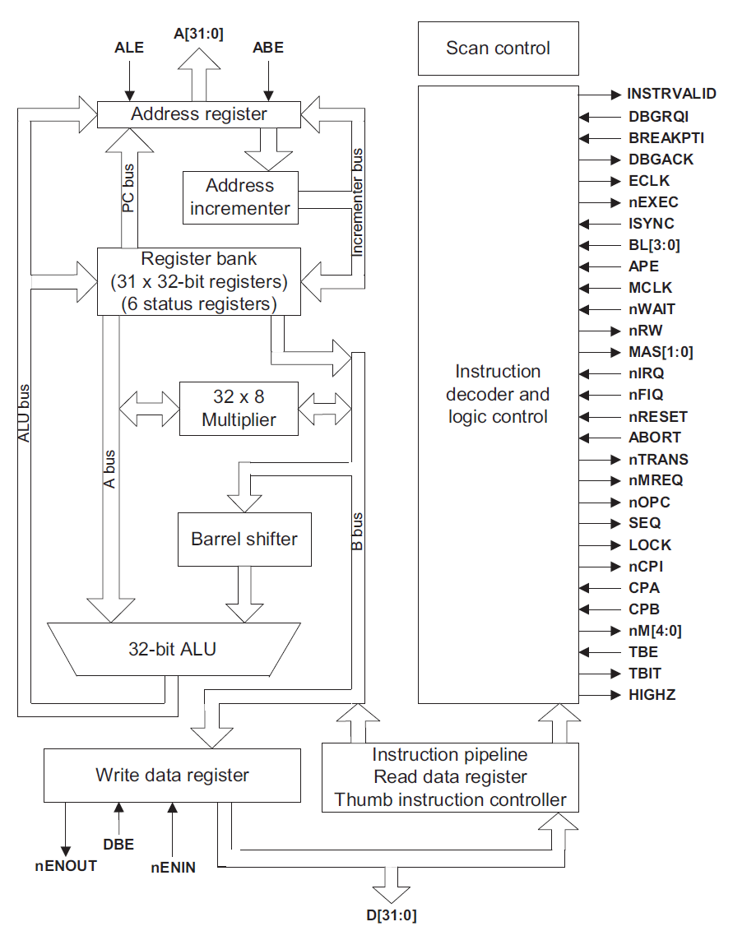
ARM7 Core Architecture

Slide 9
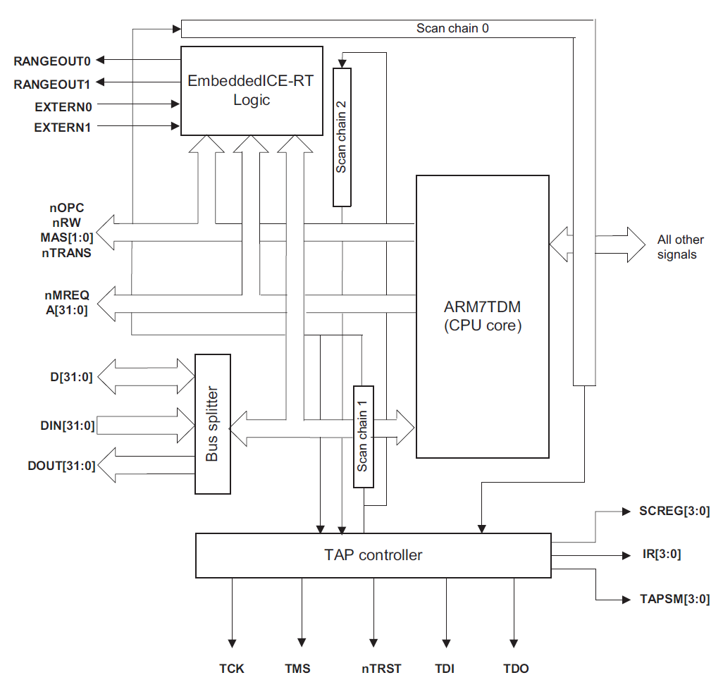
ARM7 Architecture

Slide 10
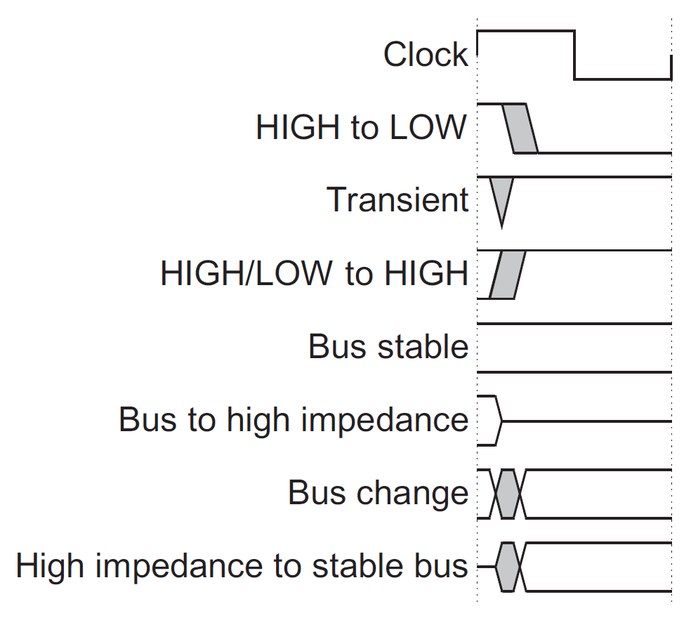
Bus Convention

Slide 11
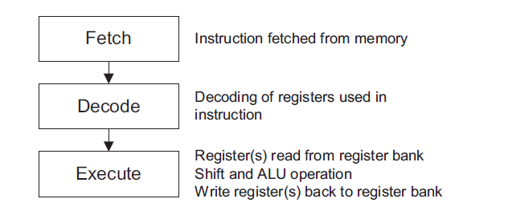
Instruction Pipelined

Slide 12
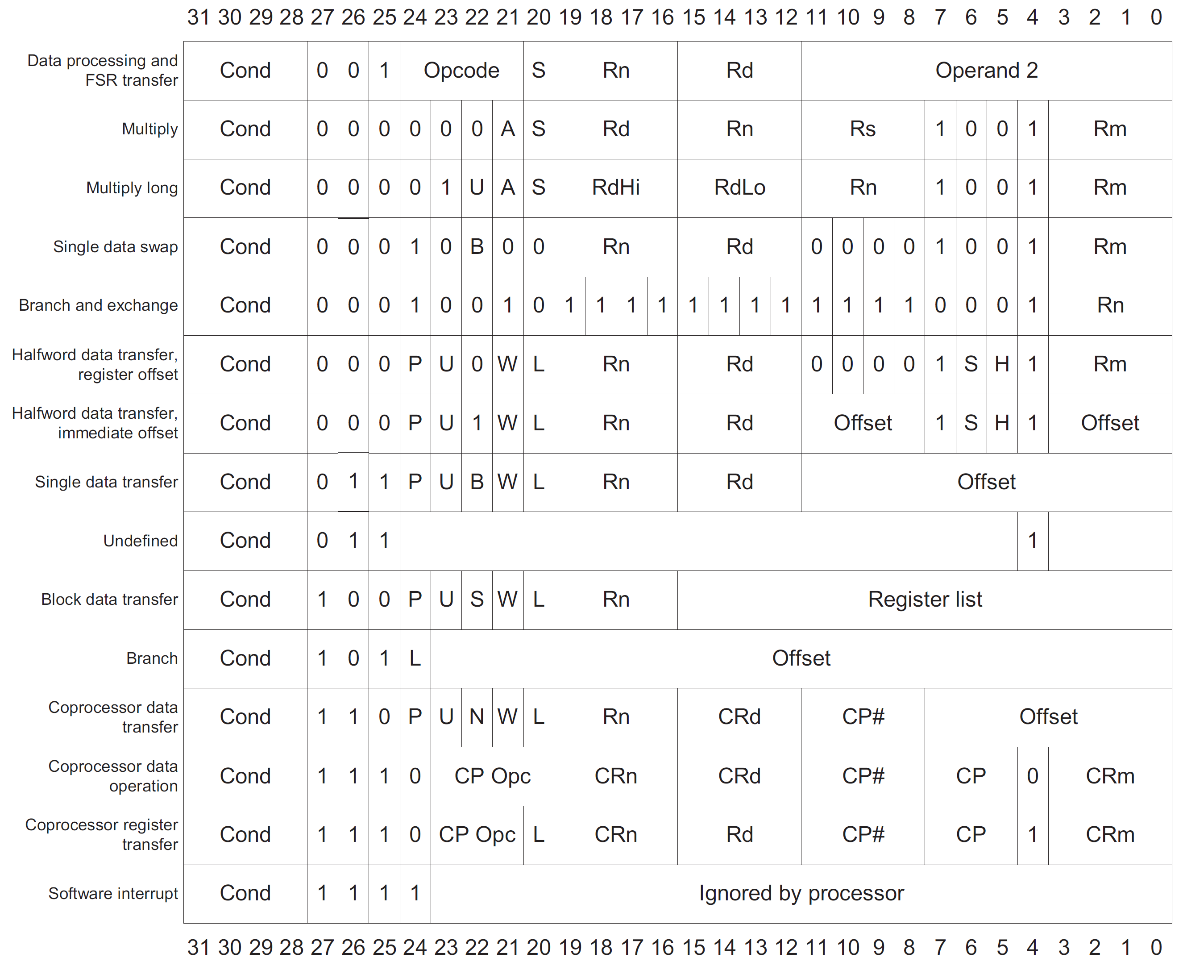
ARM instruction set formats

Slide 13
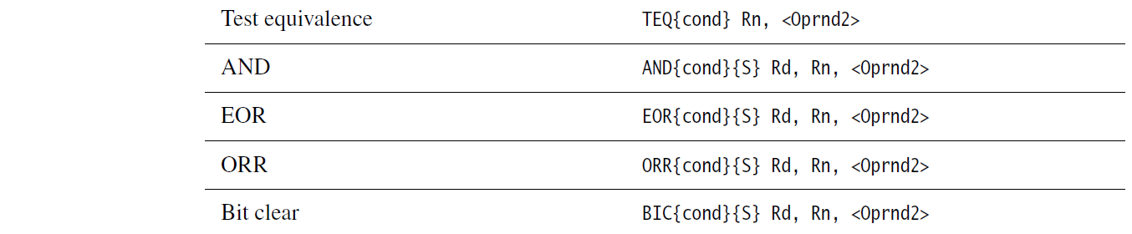

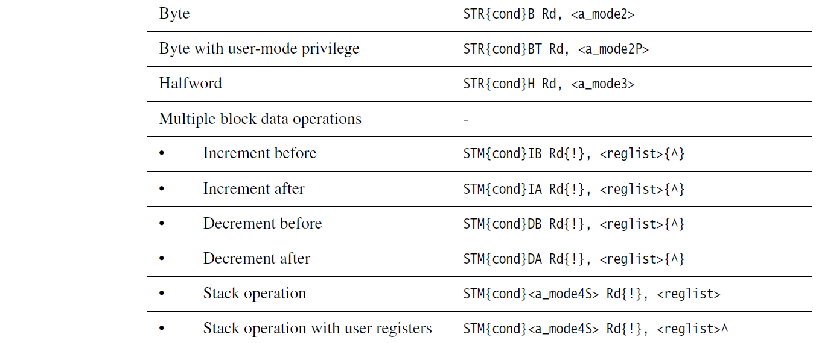
Instruction set

Slide 14
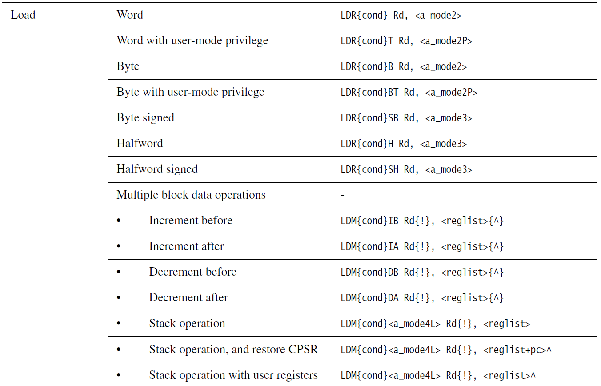
Instruction set

Slide 15
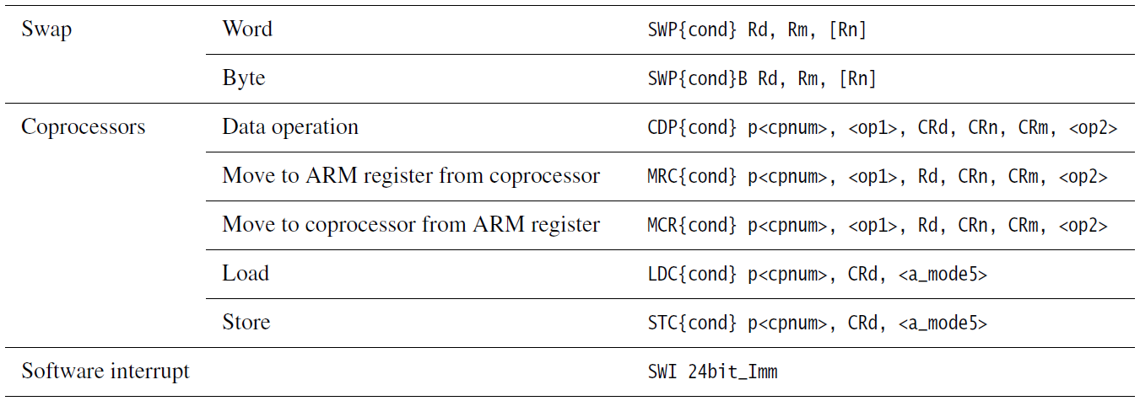
Instruction set

Slide 16
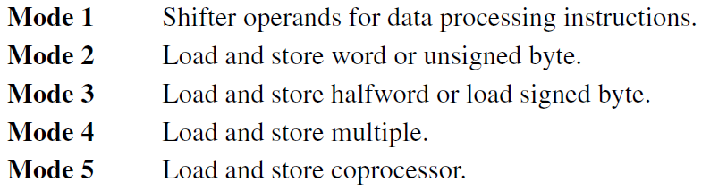
Addressing modes

Slide 17
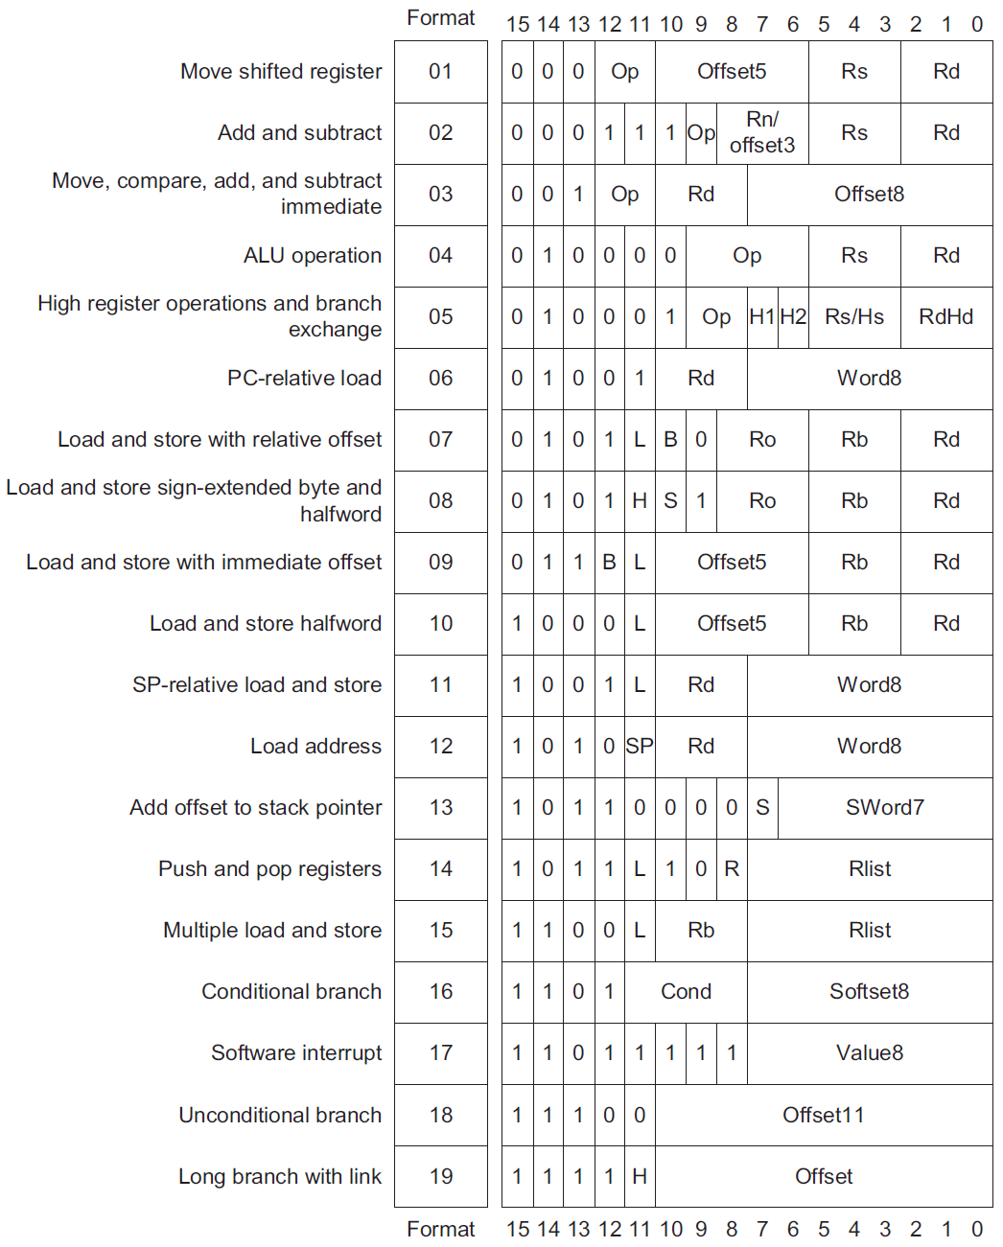
Thumb instruction set formats

Slide 18
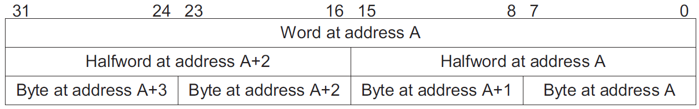
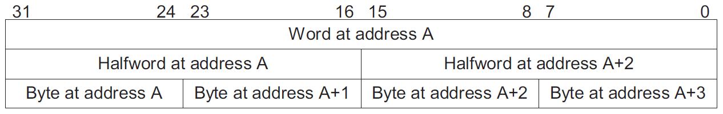
Data format
Little indian
Big indian

Slide 19
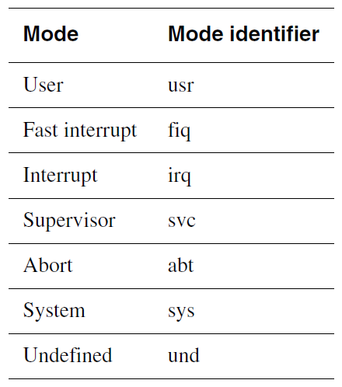
Operating mode

Slide 20
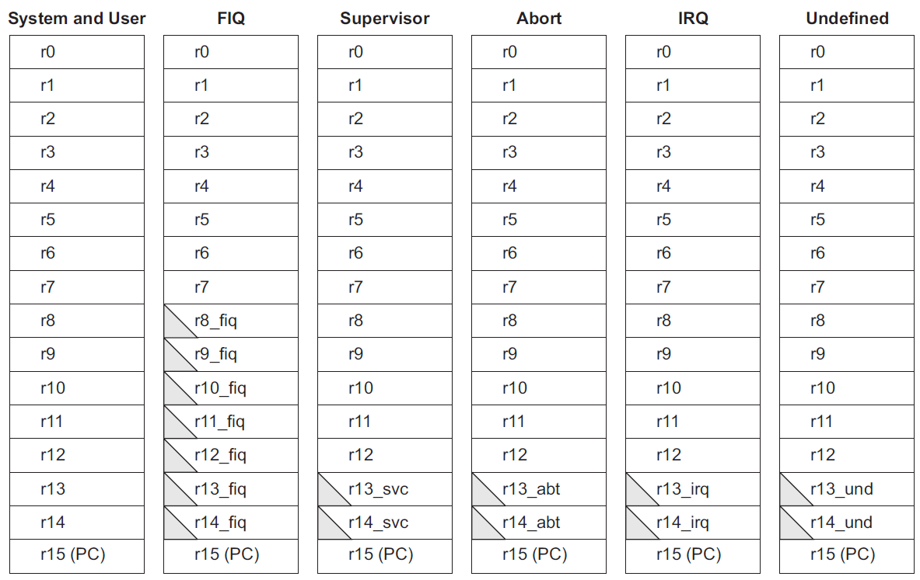
ARM general registers and program counter

Slide 21

ARM program status registers

Slide 22
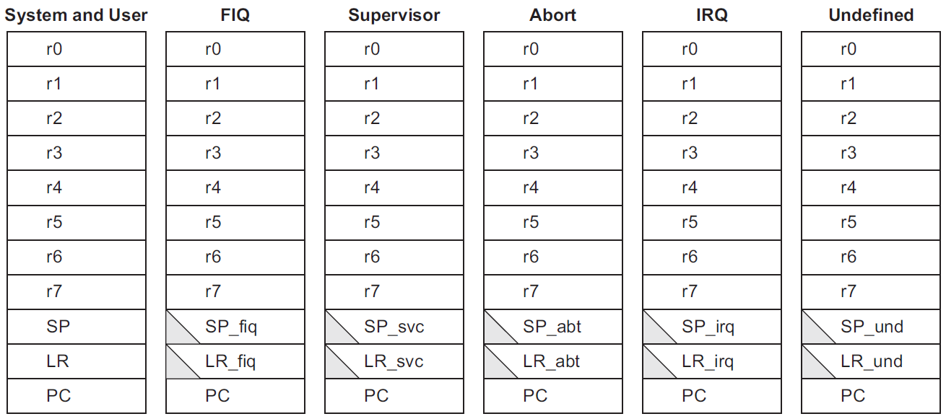
Thumb registers
General registers and program counter
Program status registers

Slide 23
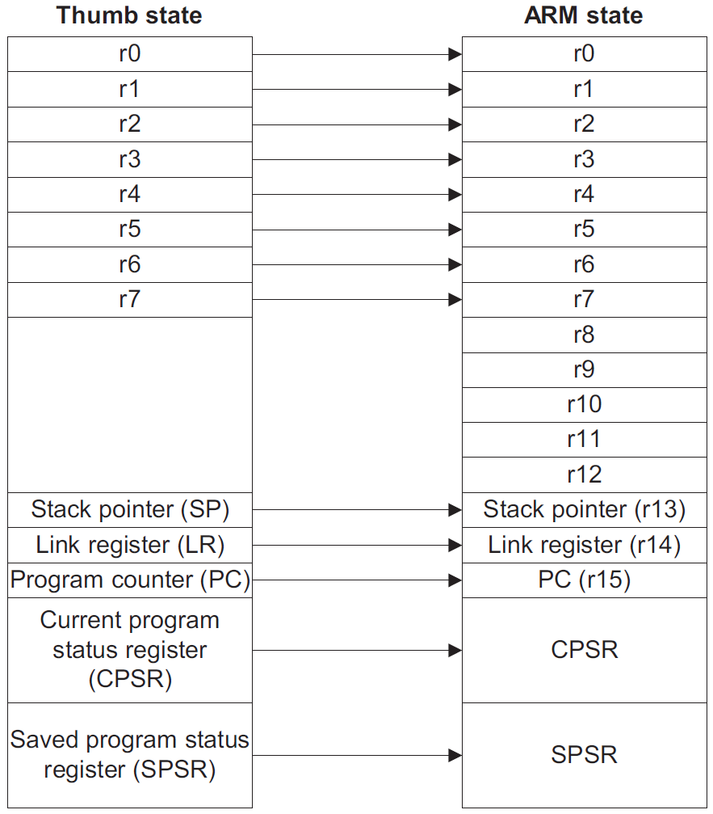
Mapping of
Thumb onto ARM registers

Slide 24
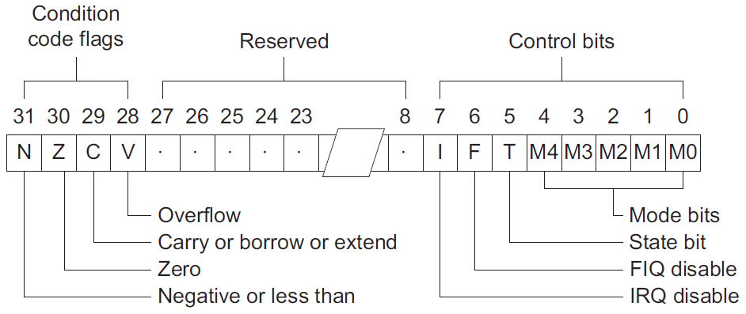
Program status register format
Interrupt disable bits
The I and F bits are the interrupt disable bits:
• when the I bit is set, IRQ interrupts are disabled
• when the F bit is set, FIQ interrupts are disabled

Slide 25
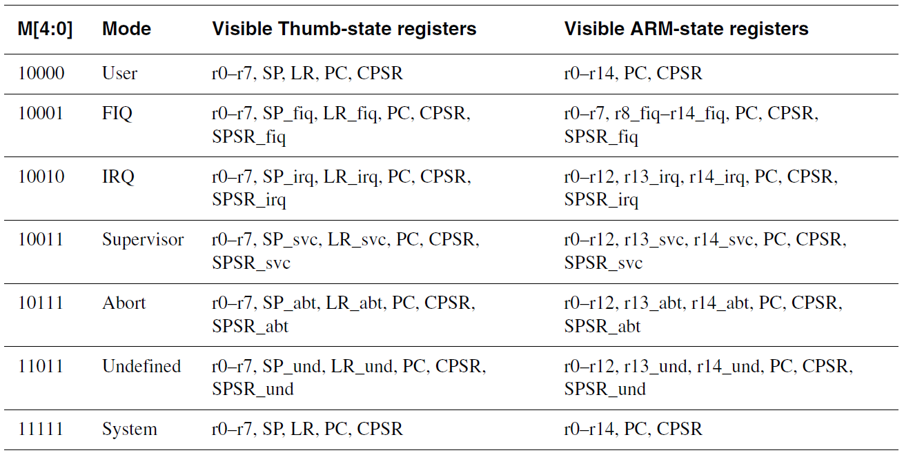
Program status register format
T bit
The T bit reflects the operating state:
• when the T bit is set, the processor is executing in Thumb state
• when the T bit is clear, the processor executing in ARM state.

Slide 26
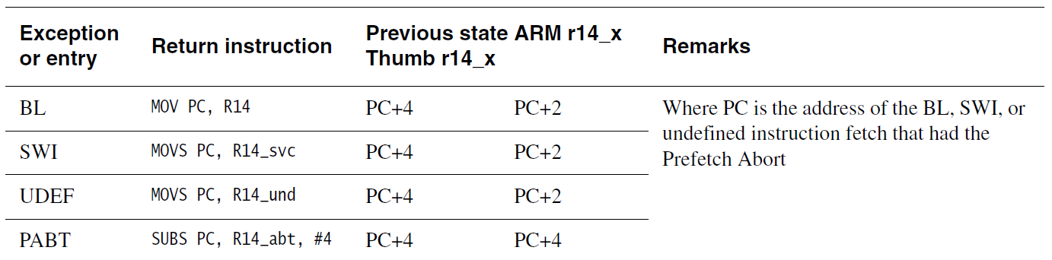
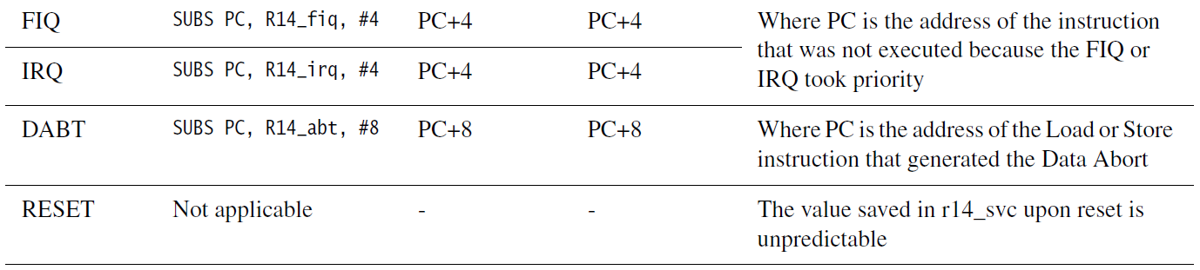
Exception entry and exit

Slide 27
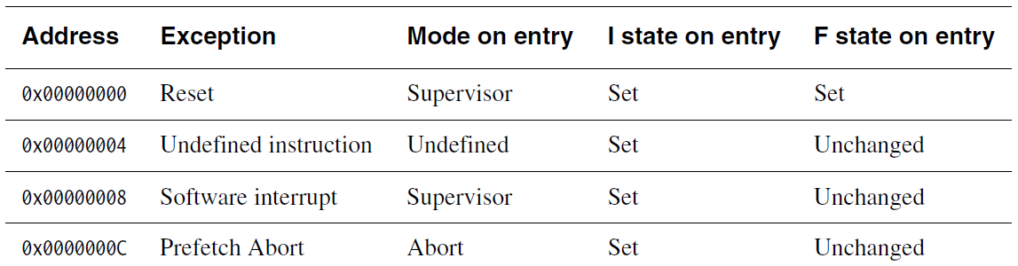
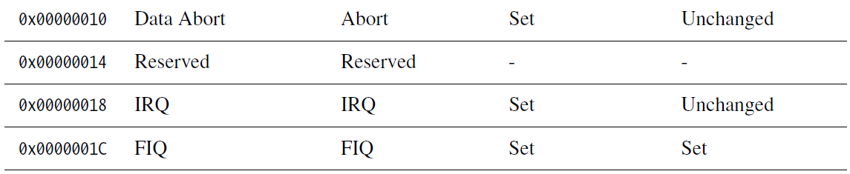
Exception vectors

Slide 28
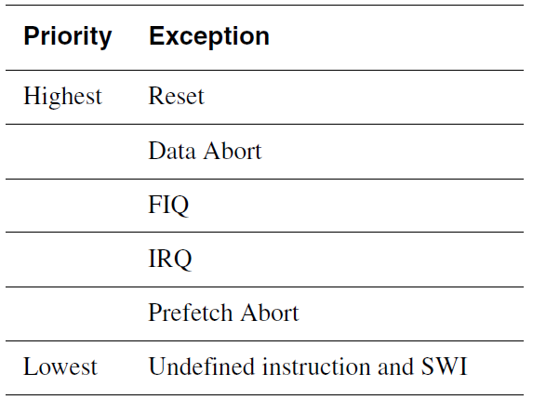
Exception priority order

Slide 29
Interrupt latencies
The calculations for maximum and minimum latency are described in:
• Maximum interrupt latencies
• Minimum interrupt latencies.
Maximum interrupt latencies
When FIQs are enabled, the worst-case latency for FIQ comprises a combination of:
Tsyncmax:
The longest time the request can take to pass through the synchronizer.
Tsyncmax:
Is four processor cycles.
Tldm:
The time for the longest instruction to complete. The longest instruction
is an LDM that loads all the registers including the PC. Tldm is 20 cycles
in a zero wait state system.
Texc:
The time for the Data Abort entry. Texc is three cycles.
Tfiq:
The time for FIQ entry. Tfiq is two cycles.

Slide 30
Reset
When the nRESET signal goes LOW a reset occurs, and the ARM7TDMI core
abandons the executing instruction and continues to increment the address bus as if still fetching word or halfword instructions.
When nRESET goes HIGH again, the ARM7TDMI processor:
1. Overwrites R14_svc and SPSR_svc by copying the current values of the PC and CPSR into them. The values of the PC and CPSR are indeterminate.
2. Forces M[4:0] to b10011, Supervisor mode, sets the I and F bits, and clears the
T-bit in the CPSR.
3. Forces the PC to fetch the next instruction from address 0x00.
Reverts to ARM state if necessary and resumes execution.
After reset, all register values except the PC and CPSR are indeterminate.

Slide 31
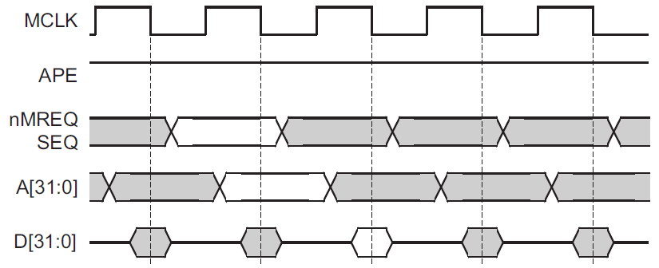
Bus cycles
Bus cycle types
The ARM7TDMI processor bus interface is pipelined. This gives the maximum time for
a memory cycle to decode the address and respond to the access request:
• memory request signals are broadcast in the bus cycle ahead of the bus cycle to which they refer
• address class signals are broadcast half a clock cycle ahead of the bus cycle to which they refer.
Single memory cycle

Slide 32
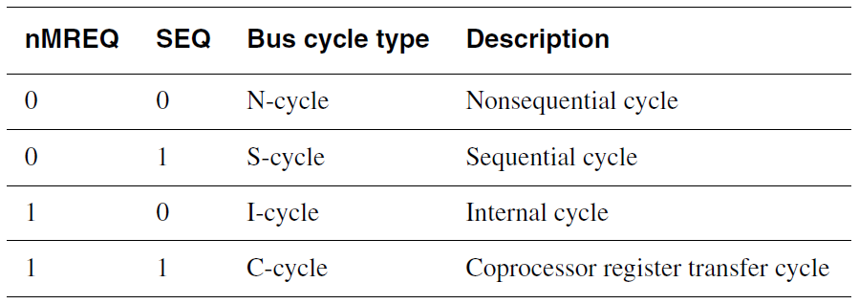
Bus cycle types

Slide 33
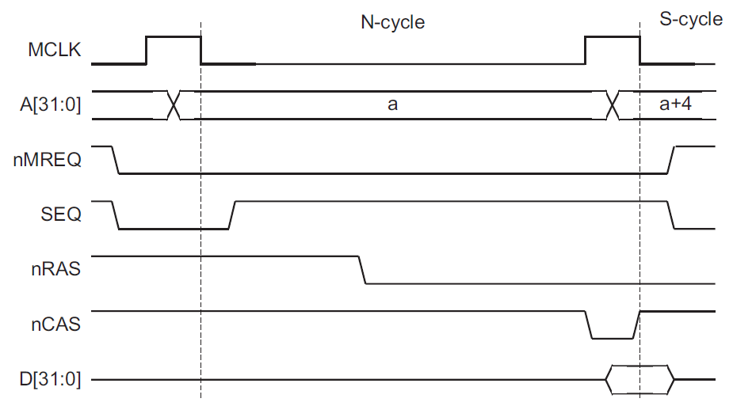
Nonsequential memory cycle

Slide 34
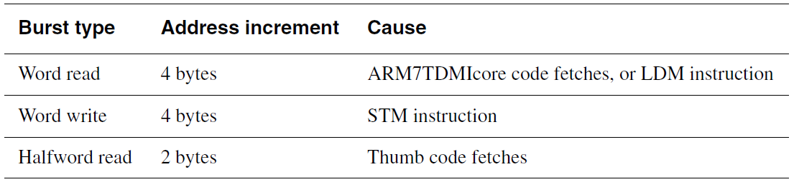
Burst type

Slide 35
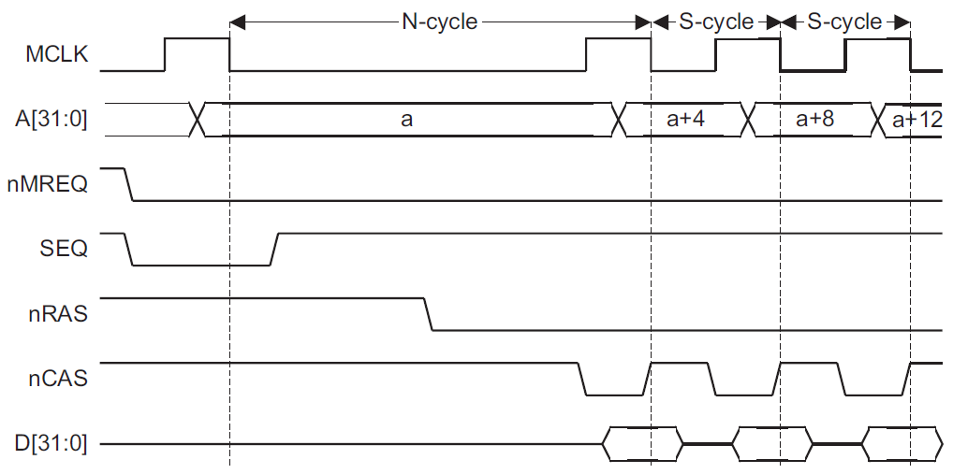
Sequential access cycles

Slide 36
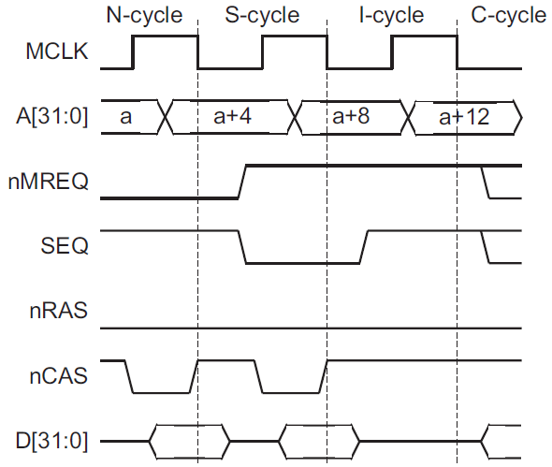
Internal cycle

Slide 37
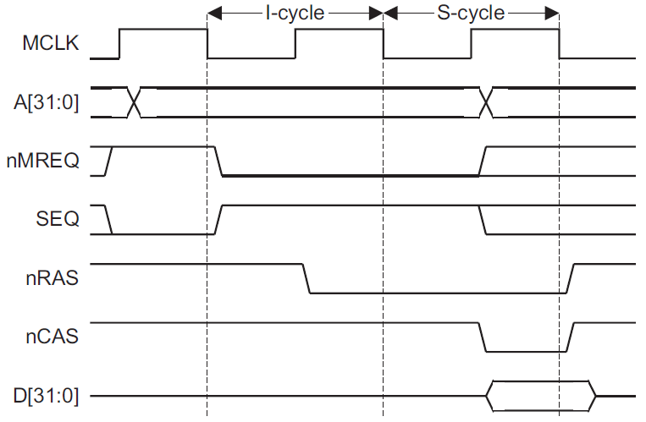
Merged IS cycle

Slide 38
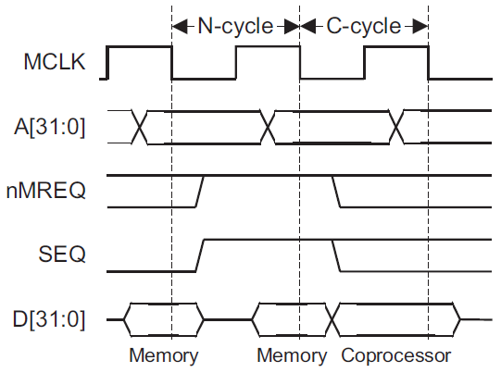
Coprocessor register transfer cycles

Slide 39
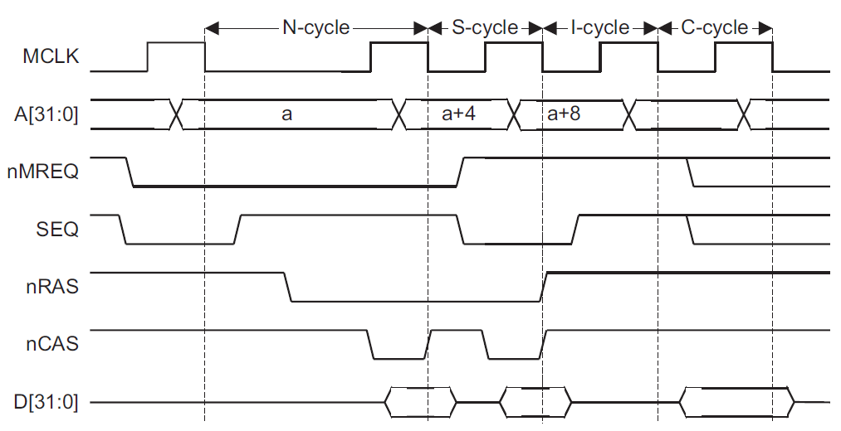
Memory cycle timing

Slide 40
Memory signals
A[31:0]:
is the 32-bit address bus that specifies the address for the transfer. All addresses
are byte addresses, so a burst of word accesses results in the address bus incrementing by four for each cycle.
The address bus provides 4GB of linear addressing space.
When a word access is signaled the memory system ignores the bottom two bits, [1:0],
and when a halfword access is signaled the memory system ignores the bottom bit, A[0].
All data values must be aligned on their natural boundaries.
All words must be word-aligned.
nRW:
specifies the direction of the transfer. nRW indicates an ARM7TDMI processor
write cycle when HIGH, and an ARM7TDMI processor read cycle when LOW. A burst
of S-cycles is always either a read burst, or a write burst. The direction cannot be
changed in the middle of a burst.

Slide 41
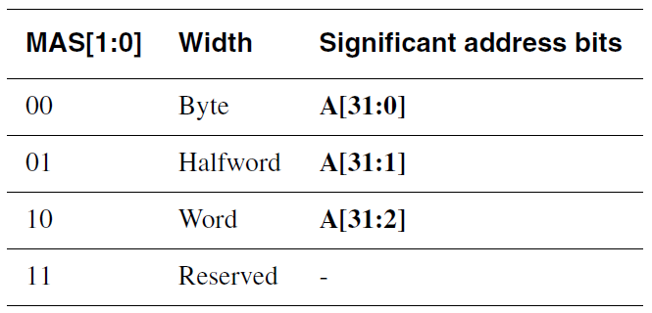
Memory signals
MAS[1:0]:
bus encodes the size of the transfer. The ARM7TDMI processor can transfer word, alfword, and byte quantities.
All writable memory in an ARM7TDMI processor based system must support the
writing of individual bytes to enable the use of the C Compiler and the ARM debug tool
chain, for example Multi-ICE.
The address produced by the processor is always a byte address. However, the memory
system must ignore the bottom redundant bits of the address.

Slide 42
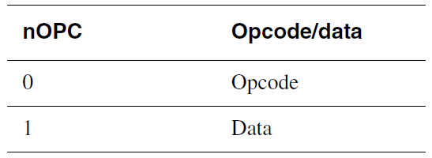
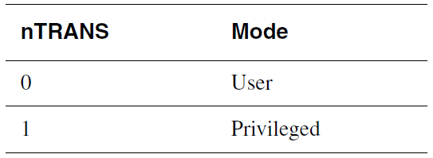
Memory signals
nOPC:
output conveys information about the transfer. An MMU can use this signal
to determine whether an access is an opcode fetch or a data transfer. This signal can be
used with nTRANS to implement an access permission scheme.
nTRANS:
output conveys information about the transfer. An MMU can use this
signal to determine whether an access is from a privileged mode or User mode. This
signal can be used with nOPC to implement an access permission scheme.

Slide 43
Memory signals
LOCK:
is used to indicate to an arbiter that an atomic operation is being performed on the bus. LOCK is normally LOW, but is set HIGH to indicate that a SWP or SWPB
instruction is being performed. These instructions perform an atomic read/write
operation, and can be used to implement semaphores.
TBIT:
is used to indicate the operating state of the ARM7TDMI processor. When in:
• ARM state, the TBIT signal is LOW
• Thumb state, the TBIT signal is HIGH.

Slide 44
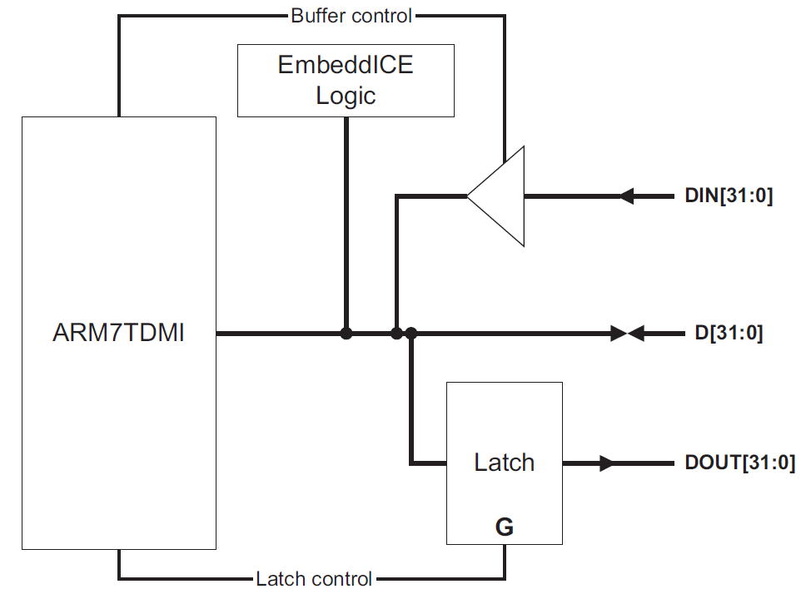
Memory signals
D[31:0], DOUT[31:0], and DIN[31:0]:
The ARM7TDMI processor provides both unidirectional data buses, DIN[31:0],
DOUT[31:0], and a bidirectional data bus, D[31:0]. The configuration input BUSEN is
used to select which is active.

Slide 45
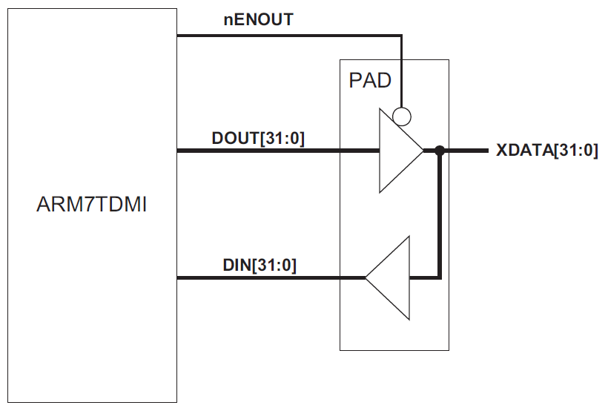
External connection of unidirectional buses

Slide 46
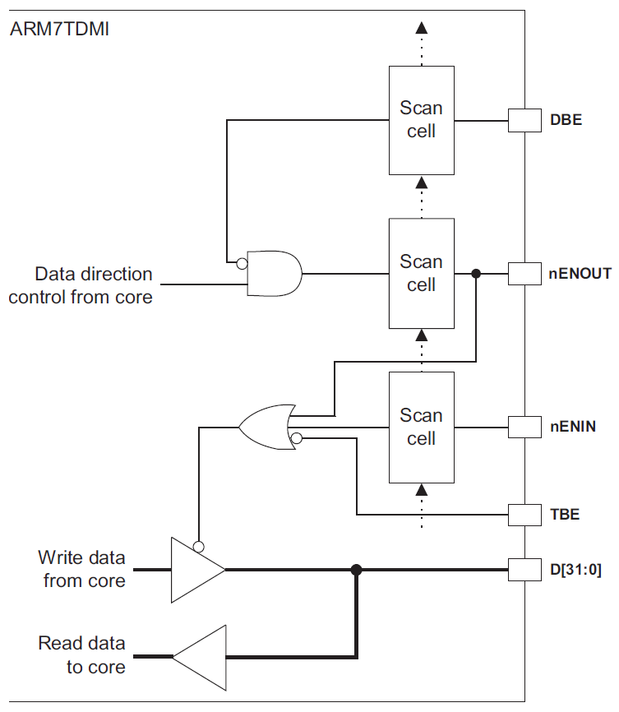
Data bus control circuit

